Slide 1


Car Theft Alarm System
Logan Paranto & Project Advisor: Arnab Purkayastha

Slide 2

Project Specs
Air pressure sensor inside car
Instant alert messages (noise)
Disable when key or the owner is in the car
Battery powered
Low power consumption
GPS tracking and alerts

Slide 3
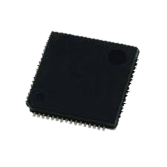
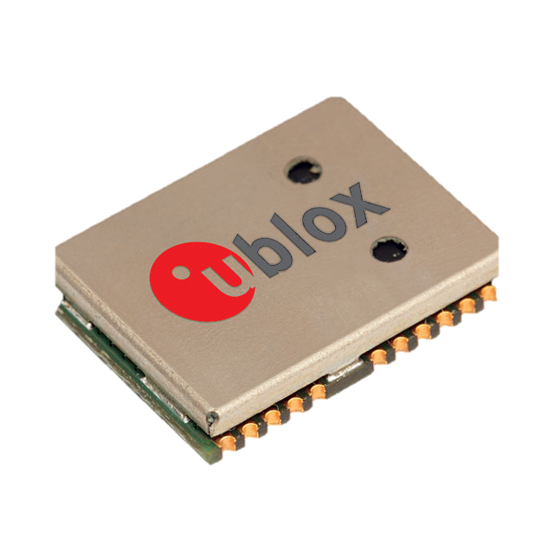
Implementation
-STM32 Microcontroller
-u-blox NEO-7M GPS Module
-STM32CubeIDE
-MPX5050GP Pressure Sensor

Slide 4
Microcontroller
GPS Module
STM32CubeIDE

Slide 5
Price
Microcontroller: $14.42
GPS Module: $31.00
Pressure Sensor: $29.41
STM32CubeIDE: Free Software

Slide 6
Past Projects
Weather Stations
-STM32 for temperature and humidity data
-GPS module for location-specific weather information
Asset Tracking System
-STM32 monitored valuable assets' location and status.
-GPS module provided location updates and alerted allies

Slide 7
Future Project Ideas
Smartphone App
-Monitor Security
-Track location in real time
-Quick alerts

Slide 8
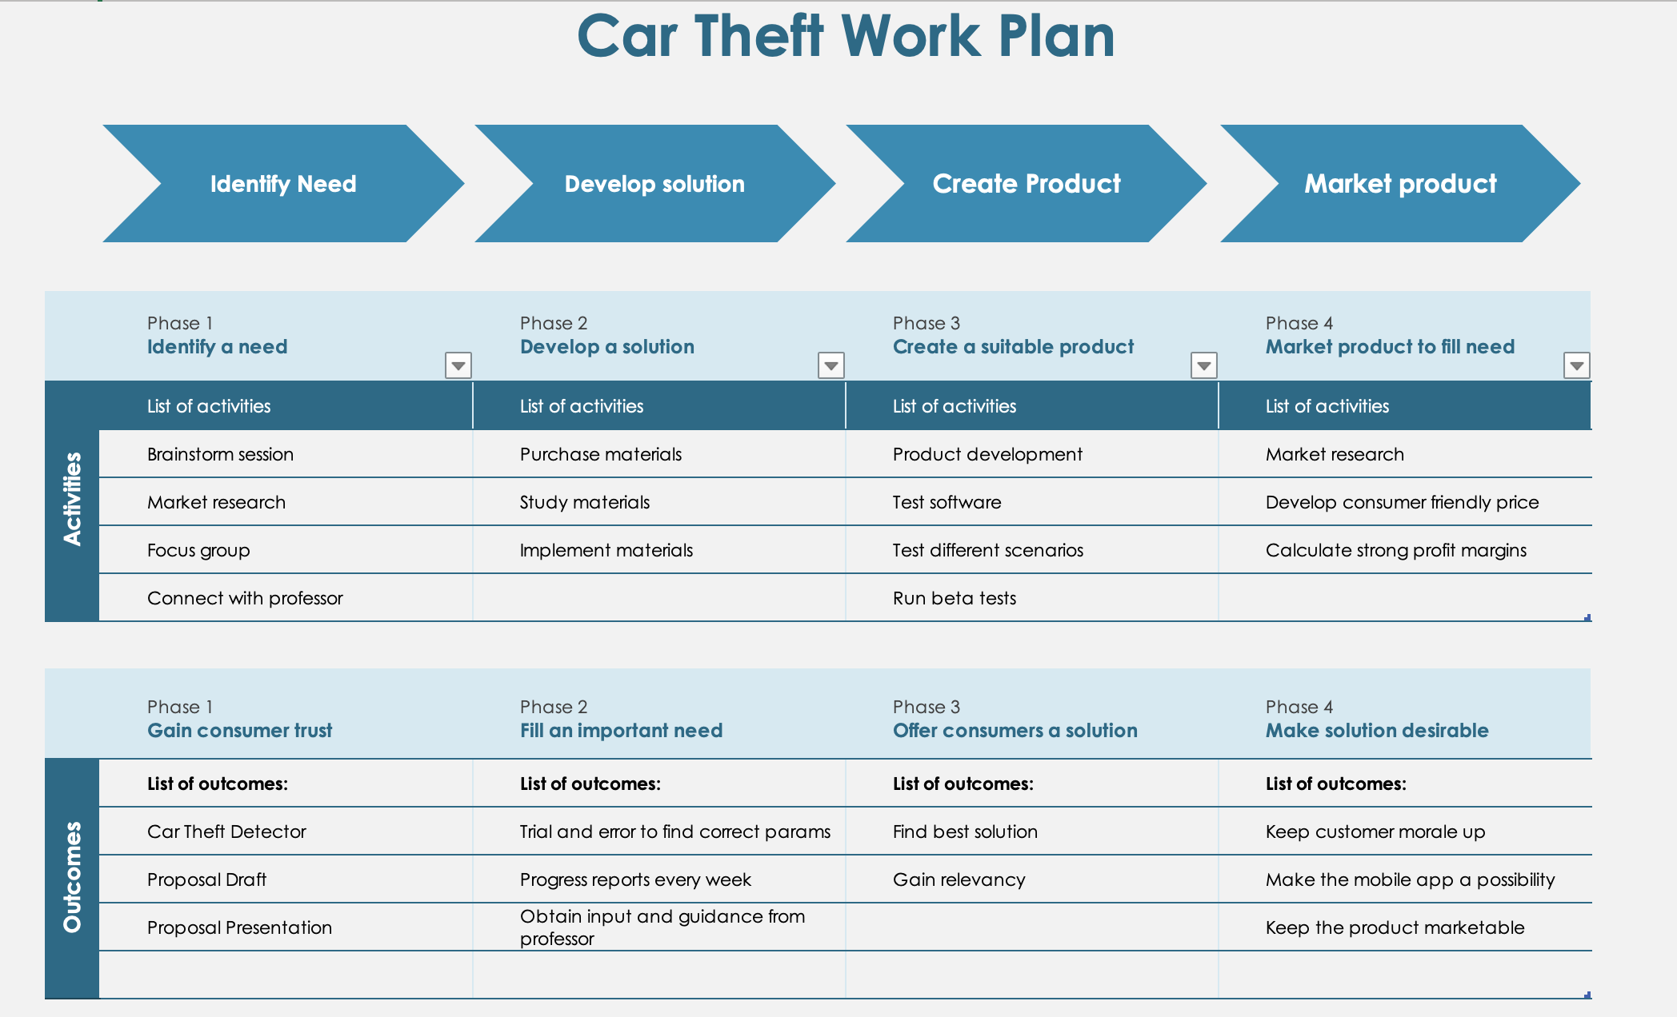
Next Steps

Slide 9
Thank You!
Questions?
Comments?

